Slide 1
Introduction to docker
Build once use anywhere

Slide 2
Installation of a software
Download the installer
Run the installer
It may fail during the installation? Why
Failed due to dependency
Environmental issues
OS compatibility issue
Older version has issue

Slide 3
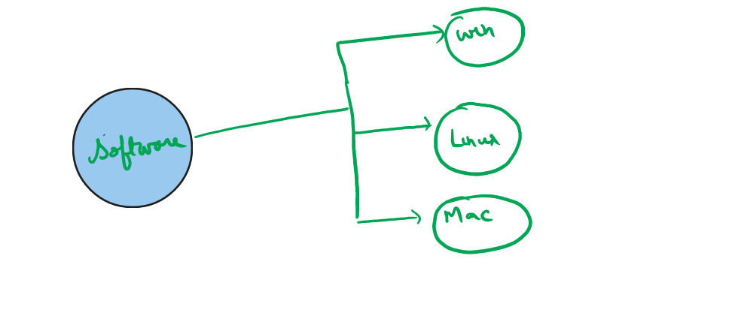
Current Challenges

Slide 4
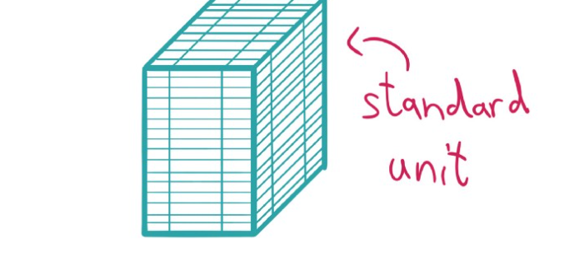
A standardized package

Slide 5
History
In 2008 a project called Linux Containers (LXC) started to pop-up in the wild, which should revolutionize the container world. LXC combined cgroup and namespace technologies to provide an isolated environment for running applications
This means that Google started their own containerization project in 2007 called Let Me Contain That For You (LMCTFY), which works mainly at the same level as LXC does. With LMCTFY, Google tried to provide a stable and API driven configuration without users having to understand the details of cgroups and its internals.

Slide 6
..
2013 we see that there was a tool written called Docker, which was built on top of the already existing LXC stack. One invention of Docker was that the user is now able to package containers into images to move them between machines.
Some years later they began to work on libcontainer, a Go native way to spawn and manage containers
In 2015, where projects like Kubernetes hit version 1.0. A lot of stuff was ongoing during that time: The CNCF was founded as part of the Linux Foundation with the target to promote containers. The Open Container Initiative (OCI)was founded 2015 as well, as an open governance structure around the container ecosystem.

Slide 7
Container runtime
Application which can run container. For example, systemd is able to run containers via systemd-nspawn, and NixOS has integrated container management as well.
All the other existing container runtimes like CRI-O, Kata Containers, Firecracker, gVisor, containerd, LXC, runc, Nabla Containers and many more. A lot of them are now part of the Cloud Native Computing Foundation (CNCF)

Slide 8
Docker
Docker is a set of platform as a service products that use OS-level virtualization to deliver software in packages called container.
Containers are isolated from one another and bundle their own software, libraries and configuration files.
They can communicate with each other through well defined channels
All containers are run by a single operating-system kernel

Slide 9
Container
Docker container is a standardized unit which can be created on the fly to deploy a particular application or environment.
It can be ubuntu/centos/or some app container (nginx)
Containers are light-weight
Docker takes advantage of several features of linux kernel to deliver its functionality
Question: If we want to use container for application what are the org requirements??

Slide 10
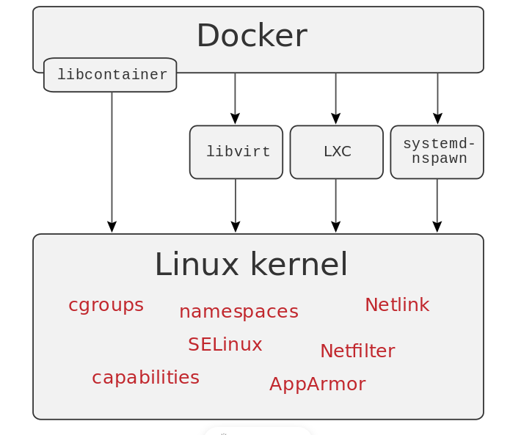
Docker internals

Slide 11
Namespaces
Docker makes use of kernel namespace to provide the isolated workspace called container
When we run container, docker creates a set of namespaces for that container. These namespace provides a set of isolation.
Each aspect of container run in separate namespace and its access is limited to that namespace
PID namespace for process isolation
NET namespace for managing network interface
IPC namespace for managing access to IPC resources
MNT namespace for managing filesystem mount points
UTS namespace for isolation kernel and version identifier

Slide 12
Cgroups
Docker makes use of kernel control group for resource allocation and isolation
A cgroup limits an application to a specific set of resources
Control group allow Docker Engine to share available hardware resources to containers and optionally enforce limits and constraints
Memory cgroup
CPU cgroup
Devices cgroup
BlkIO cgroup

Slide 13
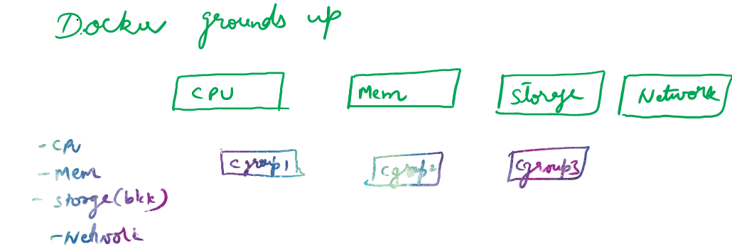
..

Slide 14
Union File systems
Union file systems operates by creating layers, making them lightweight and fasters
Docker Engine uses UnionsFS to provide the building blocks for containers
Union filesystem works on the top of the other file system. It works on mounting mechanism
In other words, it mounts multiple directories to a single root.
AUFS,OverlayFS are few popular UnionFS

Slide 15
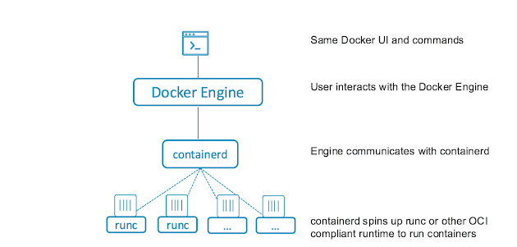
..

Slide 16
Containerd
What Is containerd?
containerd is a Docker-developed container runtime that manages the life cycle of a container on a physical or virtual machine (i.e., a host). It creates, starts, stops, and destroys containers. It can also pull container images from container registries, mount storage, and enable networking for a container.
containerd is a daemon, meaning it’s a computer program that runs as a background process rather than being under the direct control of an interactive user. It’s available for both Linux and Windows.
containerd manages the complete container life cycle of its host system—from image transfer and storage to container execution and supervision to low-level storage to network attachments and more.

Slide 17
containerd
containerd is a Docker-made runtime solution. This daemon is available for Linux and Windows OSes. As part of the Docker project, containerd manages image transfer and storage, as well as container creation, execution and supervision.
Kubernetes does not need the entire Docker platform to use containerd. With the CRI compatibility plugin, Kubernetes and containerd can communicate directly.

Slide 18
Open Container Initiative (OCI)
Docker and other important container industry actors established the Open Container Initiative (OCI) in 2015. The OCI aims to create standards for container formats and runtimes. Currently, the OCI has two specifications:
image-spec - the image specification that outlines how to create an OCI-compliant image.
runtime-spec - the runtime specification for unpacking the filesystem bundle.

Slide 19
runC
runC is a universal container runtime created by Docker. Although it is a part of the Docker set of tools, it does not require Docker platform to run.
Some important features of runC are:
Full Linux namespaces support.
Native support for Linux security features, such as AppArmor, SELinux, etc.
Windows 10 containers native support.
Containers that runC creates and manages are OCI compliant.

Slide 20
Container Runtime Interface (CRI)
Although Kubernetes is a container orchestration platform, at the lowest level, it also needs to create and manage containers. To achieve this, Kubernetes uses container runtimes.
In the beginning, Docker Engine was the only available runtime on the platform. But the popularity of containerization resulted in competing solutions and the need for Kubernetes to support them all. With the Container Runtime Interface plugin, Kubernetes can communicate with all major runtimes.

Slide 21



